Slide 1
Subtopic N3.13 – Highest Common Factor
LEARNING OUTCOME: To understand and be able to list the common factors of a number, identifying the highest common factor
Objectives:
Keywords:
Factor
Highest Common Factor
To understand the concept of highest common factor.
To be able to recognise common factors and identify the highest.
To be able to apply the concept of highest common factors in problem solving.
Introduction – Read and annotate:
The highest common factor (HCF), is the biggest number that can divide two (or more) numbers
evenly, with no remainder. Think of it as the largest number that both numbers "share" as a factor. The
HCF is useful for simplifying fractions, dividing things into equal parts, and finding the biggest group
that something can be split into evenly.
Definition
Characteristics
The largest integer which is a factor of two or more given positive integers.
Will be less than or equal to the smallest of the given numbers.
Often abbreviated to HCF
Examples
Highest common factor
Non - Examples
HCF of 8 and 12 = 4
HCF of 30 and 15 = 15
HCF of 4 and 15 = 1
LCM of 4, 6 and 10 = 2
HCF of 1 and 2 ≠ 2
HCF of 4 and 8 ≠ 8
HCF of 4 and 5 ≠ 20
Calculating the highest common factor of two numbers
Example 1 - I do…
Example 2 – We do…
Example 3 – You do…
Steps | Find the HCF of 10 and 15 | Find the HCF of 16 and 24 | Find the HCF of 12 and 18
1) List all the factors of each number. 2) Identify the factors common to both lists, then circle the highest common factor. | Factors of 10 1, 2, 5, 10 Factors of 15 1, 3, 5, 15 HCF = 5 | Factors of 16 1, 2, 4, 8, 16 Factors of 24 1, 2, 3, 4, 6, 8, 12, 24 HCF = 8 | Factors of 12 1, 2, 3, 4, 6, 12 Factors of 18 1, 2, 3, 6, 18 HCF = 6

Slide 2
Independent Practice
1. Work out the highest common factor of the following pairs of numbers:
a) 4 and 14 | b) 6 and 14 | c) 6 and 9
d) 9 and 21 | e) 6 and 15 | f) 10 and 17
g) 30 and 45 | h) 40 and 60 | i) 28 and 63
j) 24 and 36 | k) 16 and 28 | l) 18 and 45
m) 150 and 200 | n) 12 and 54 | o) 90 and 270
p) 39 and 65 | q) 12 and 1 | r) 12 and 2
s) 12 and 3 | t) 12 and 4 | u) 12 and 5
2
2
3
3
3
1
15
20
7
12
4
9
50
6
90
13
1
2
3
4
1

Slide 3
Independent Practice
v) 12 and 6 | w) 12 and 7 | x) 12 and 8
y) 12 and 9 | z) 12 and 10 | aa) 12 and 11
ab) 12 and 12 | ac) 12 and 13 | ad) 12 and 14
ae) 12 and 15 | af) 12 and 16 | ag) 12 and 17
ah) 12 and 18 | ai) 12 and 19 | aj) 12 and 20
ak) 12 and 30 | al) 12 and 40 | am) 12 and 50
an) 12 and 60 | t) 1 and 2 | u) 2 and 1
6
1
4
3
2
1
12
1
2
3
4
1
6
1
4
6
4
2
12
1
1

Slide 4
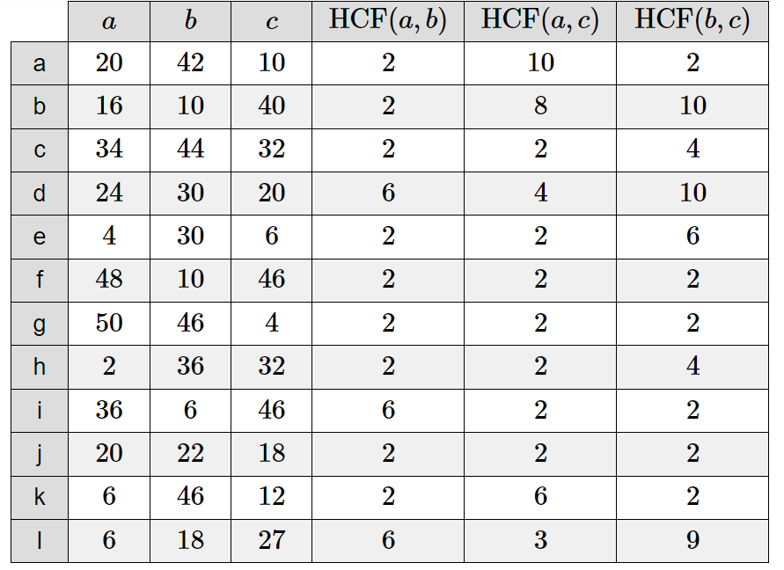

2. Complete the table:
3. The highest common factor of 30 and 75 is the square root of a number. What is the number?
225

Slide 5
4. Answer the following questions:
a) A PE teacher has to organise two year groups into netball teams, each separately. Year 7 has 70 students and Year 8 has 98 students. If each year group must be split equally into teams of all the same size, what is the largest team size she can use?
b) Alannah has two lengths of ribbon. One length of ribbon is 36cm long and the other length is 45cm long. Alannah wants to cut lengths of ribbon into shorter lengths that are of equal length. Alannah does not want any ribbon left over. What is the longest possible length for each of the shorter lengths of ribbon?
c) Helen thinks of two numbers. The highest common factor of her two numbers is 5. The lowest common multiple of her two numbers is a multiple of 12. Write down two possible numbers that Helen could be thinking of.
d) Lenny wants to cut identical squares, as big as he can, from a piece of paper measuring 168mm by 196mm. What is the length of each square?
14
9cm
5 and 60 or 5 and 120
28mm x 28mm

Slide 6
e) Olivia thinks of two numbers. The LCM of the two numbers is 36. The HCF of the two numbers is 3. Both numbers are less than 5. Write down two possible numbers that Olivia could be thinking of.
f) Niamh thinks of a number. The HCF of the two numbers is 8. The lowest common multiple of the two numbers is a multiple of 5. Write down two possible numbers Niamh could be thinking of.
g) Here are some properties of a number: It is a common factor of 288 and 360. It is a common multiple of 4 and 6. It is larger than 25. Find the two possible numbers with these properties.
h) Kenny is thinking of two numbers greater than 10. He says: ”The highest common factor (HCF) of my two numbers is 7. The lowest common multiple (LCM) of my two numbers is 84” Write down the two numbers that Kenny is thinking of.
e.g. 12 and 9
e.g. 40 and 8
36 and 72
28 and 42

Slide 7

i) Find two numbers between 100 and 150 that have a HCF of 22.
j) The highest common factor of 90 and x is 18. The lowest common multiple of 90 and x is 540. Find the value of x.
k) The highest common factor of x and 12 is 6. The lowest common multiple of x and 12 is 180. Find the value of x.
l) Sam has completed his maths homework. Can you spot any mistakes?
He has forgotten that 1 and 18 are factors of 18 and that 1 and 36 are factors of 36. 18 would actually be the HCF.
132
108
90

Slide 8
Calculating the highest common factor of more than two numbers
Example 4 - I do…
Example 5 – We do…
Example 6 – You do…
Steps | Find the HCF of 12, 6 and 15 | Find the HCF of 27, 33 and 12 | Find the HCF of 30, 15 and 25
1) List all the factors of each number. 2) Identify the factors common to each list, then circle the highest common factor. | Factors of 12 1, 2, 3, 4, 6, 12 Factors of 6 1, 2, 3, 6 Factors of 15 1, 3, 5, 15 HCF = 3 | Factors of 27 1, 3, 9, 27 Factors of 33 1, 3, 11, 33 Factors of 12 1, 2, 3, 4, 6, 12 HCF = 3 | Factors of 30 1, 2, 3, 5, 6, 10, 15, 30 Factors of 15 1, 3, 5, 15 Factors of 25 1, 5, 25 HCF = 5
Independent Practice
5. Work out the highest common factor of the following pairs of numbers:
a) 8, 20 and 12 | b) 10, 25 and 13 | c) 12, 24 and 30
d) 9, 36 and 45 | e) 100, 125 and 200 | f) 56, 42 and 98
g) 80, 16 and 96 | h) 14, 49 and 7 | i) 4, 37 and 51
HCF = 4
HCF = 1
HCF = 6
HCF = 9
HCF = 25
HCF = 7
HCF = 16
HCF = 7
HCF = 1

Slide 9
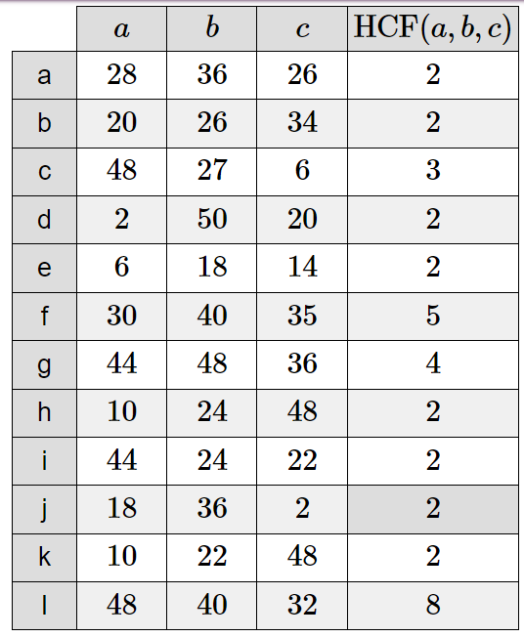
6. Complete the table:

Slide 10
7. Answer the following questions:
a) Martin says that 6 is a common factor of 42, 36 and 50. Is he correct?
b) An aid effort shares food and drink equally to each person in a refugee camp. If the total ration for a day is 136 apples, 204 oat biscuits and 340 small bottles of water, how many refugees are there in the camp?
c) 249 blue smarties, 252 pink smarties and 210 yellow smarties are shared equally among some students with none left over. What is the largest possible number of students?
d) Three planks are to be cut into pieces of all the same size. The planks have lengths 84cm, 156cm and 180cm. What is the greatest possible length of each piece?
No. 6 is not a factor of 50.
68
42
12cm each

Slide 11
Identifying the skill – LCM and HCF mixed practice
8. For each question, circle whether you need to find the highest common factor or the lowest common multiple. Once you have done this for all questions, go back through and work out the answers to the problems. :
a) Rehan likes collecting marbles. Swirler marbles come in packs of 15. Fish-eye Marbles come in packs of 25. Rehan wants the same number of Swirlers as Fish-eyes. What is the smallest number of each pack that Rehan can buy?
LCM / HCF
b) Sophie is organising a charity hot dog sale. There are 18 bread rolls in each packet. There are 15 hot dog rolls in each packet. Sophie buys exactly the same number of bread rolls as hot dogs. What is the smallest number of each packet that Sophie can buy?
LCM / HCF
c) Two wires are 12 m and 16 m long. The wires are to be cut into pieces of equal length. Find the maximum length of each piece.
LCM / HCF
d) Rita is going to make some cheeseburgers for a party. She buys some packets of cheese slices and some boxes of burgers. There are 20 cheese slices in each packet. There are 12 burgers in each box. Rita buys exactly the same number of cheese slices and burgers. a. How many packets of cheese slices and how many boxes of burgers does she buy? b. Rita wants to put one cheese slice and one burger into each bread roll. She wants to use all the cheese slices and all the burgers. How many bread rolls does Rita need?
LCM / HCF
5 packs of Swirler
3 packs of Fish-eye
5 packets of bread rolls
6 packets of hot dog rolls
4m pieces
a) 3 packets of cheese slices
5 boxes of burgers
b) 60 bread rolls

Slide 12
e) Rachel has 24 red candies and Maya has 18 green candies. They want to arrange the candies in such a way that each row contains an equal number of candies and also each row should have only red candies or green candies. What is the greatest number of candies that can be arranged in each row?
LCM / HCF
f) Egbert is making trail mix out of 18 bags of nuts and 9 bags of dried fruit. He wants each new portion of trail mix to be identical, containing the same combination of bags of nuts and bags of dried fruit, with no bags left over. What is the greatest number of portions of trail mix Egbert can make?
LCM / HCF
g) Six friends are having dinner together in their local restaurant. The first eats there every day, the second eats there every other day, the third eats there every third day, the fourth eats there every fourth day, the fifth every fifth day and the sixth eats there every sixth day. They agree to have a party the next time they all eat together there. In how many days’ time is the party?
LCM / HCF
h) Boxes that are 12 inches tall are being stacked next to boxes that are 18 inches tall. What is the shortest height at which the two stacks will be the same height?
LCM / HCF
i) For a dinner party, Abraham is creating individual servings of starters. He has 9 carrot sticks and 18 celery sticks. If he wants each serving to be identical, with no food left over, what is the greatest number of servings Abraham can create?
LCM / HCF
6
36 inches
9 servings

